Slide 1

BUSINESS ADMINISTRATION
SOFTWARE
ALA-TOO INTERNATIONAL UNIVERSITY
Spring Semester 2025-2026

Slide 2
***
Conceptual integrity is central to product quality.
— Frederick P. Brooks Jr.

Slide 3
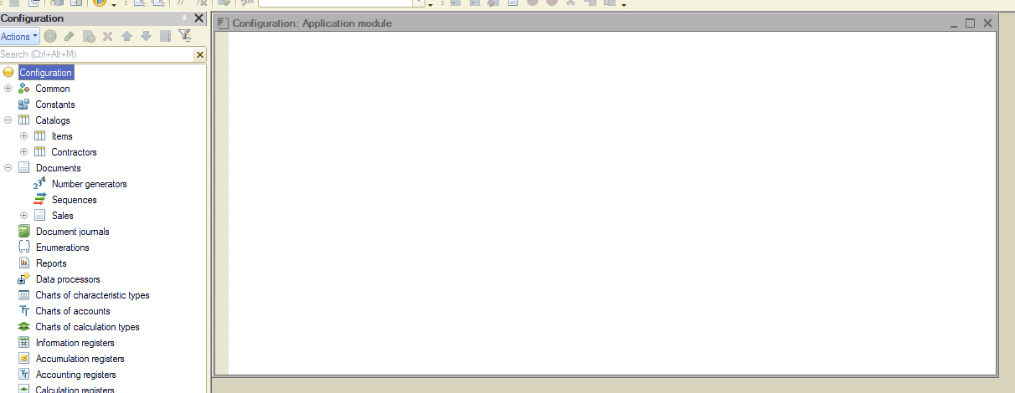
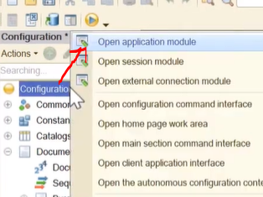
GENERAL PURPOSE MODULE DESIGNER MODE

Slide 4
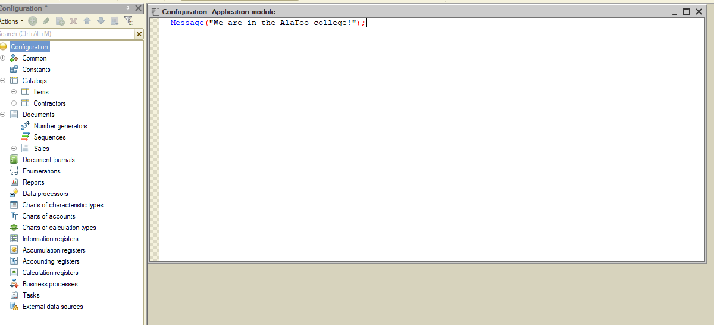
GENERAL PURPOSE MODULE DESIGNER MODE

Slide 5
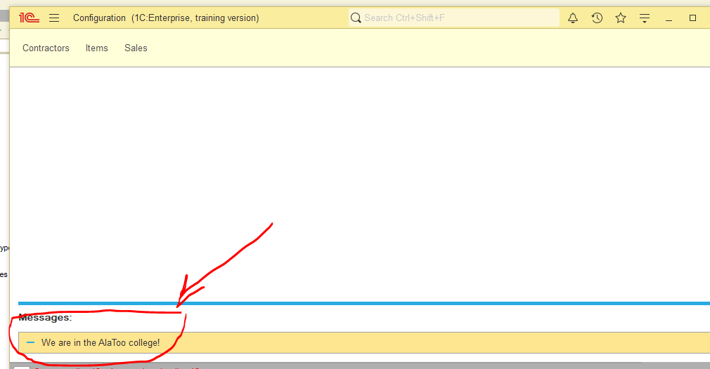
GENERAL PURPOSE MODULE ENTERPRISE MODE
Message on launch

Slide 6
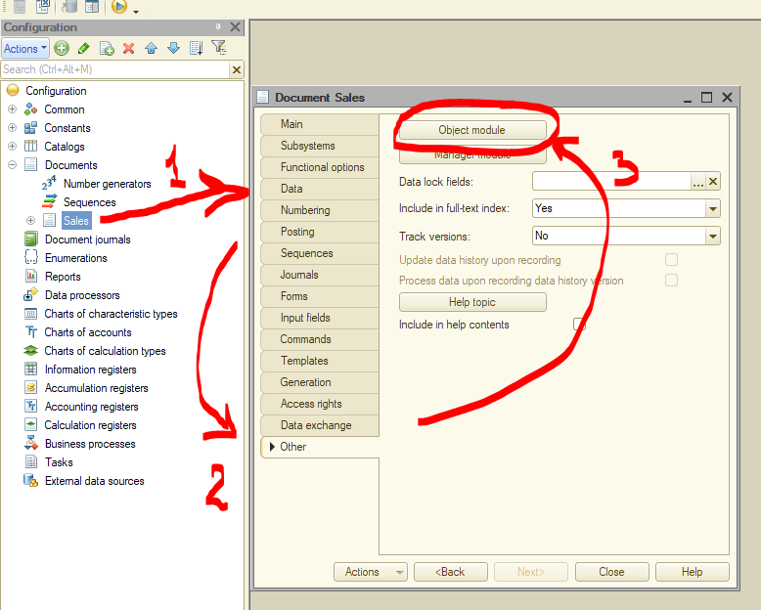
OBJECT MODULE DESIGNER MODE

Slide 7
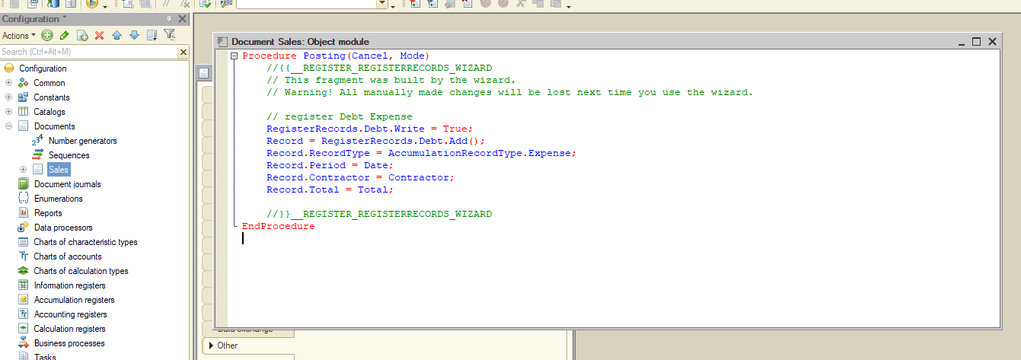
OBJECT MODULE DESIGNER MODE
The procedure which get executed when posting a document , adding records to specified register

Slide 8
TWO MAIN IDEAS DESIGNER MODE
GENERAL PURPOSE MODULE
Frequently used procedures and functions
General-purpose source code
OBJECT MODULE
Contains code specific for the object
Examples: catalog and document

Slide 9

COMMENTS DESIGNER MODE

Slide 10
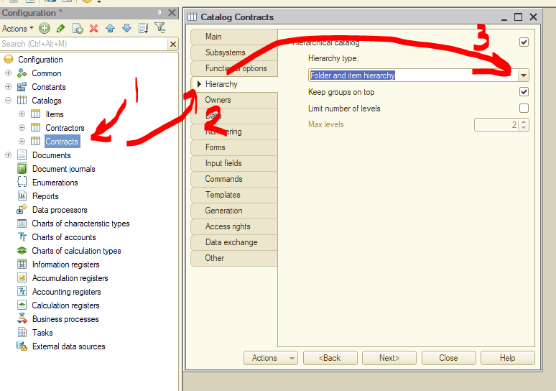
HIERARCHY (FOLDER) DESIGNER MODE

Slide 11
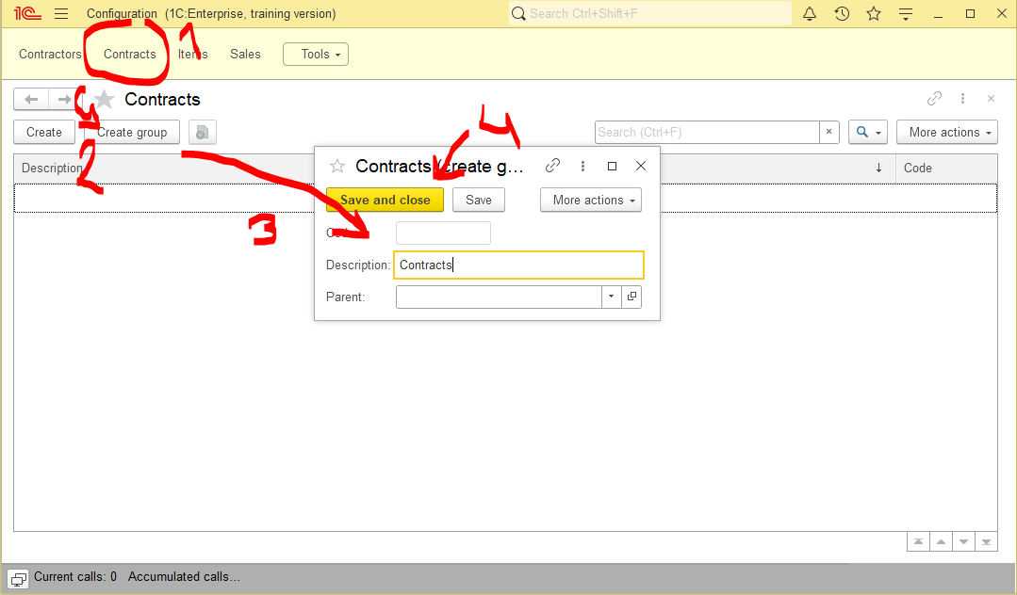
HIERARCHY (FOLDER) ENTERPRISE MODE

Slide 12
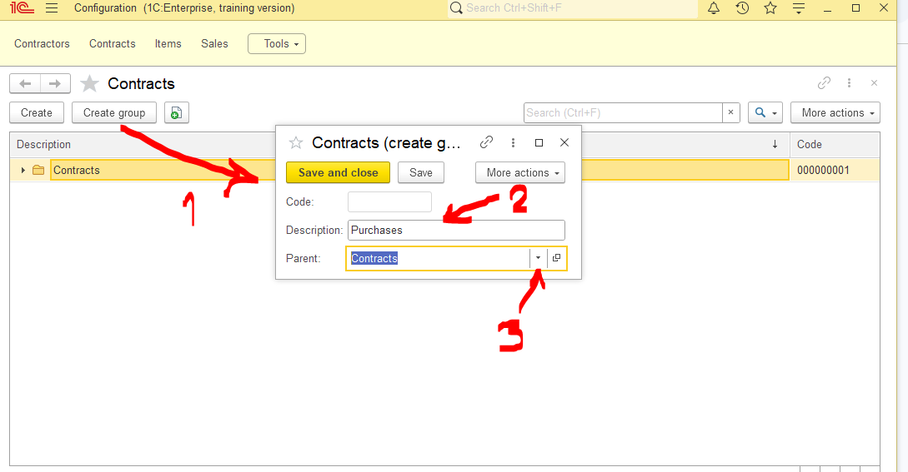
HIERARCHY (FOLDER) ENTERPRISE MODE

Slide 13
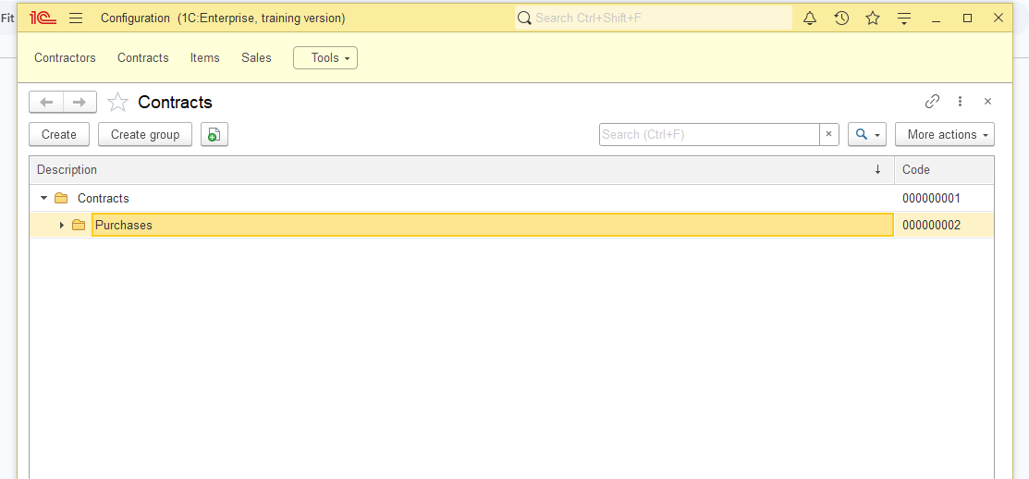
HIERARCHY (FOLDER) ENTERPRISE MODE

Slide 14
HIERARCHY (FOLDER) ENTERPRISE MODE

Slide 15
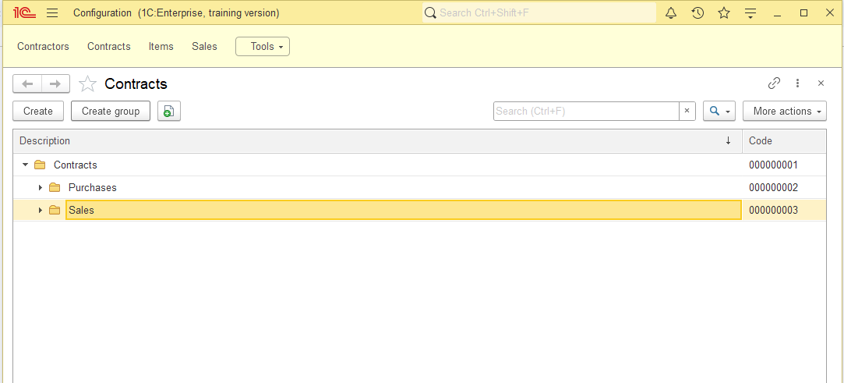
HIERARCHY (FOLDER) ENTERPRISE MODE

Slide 16
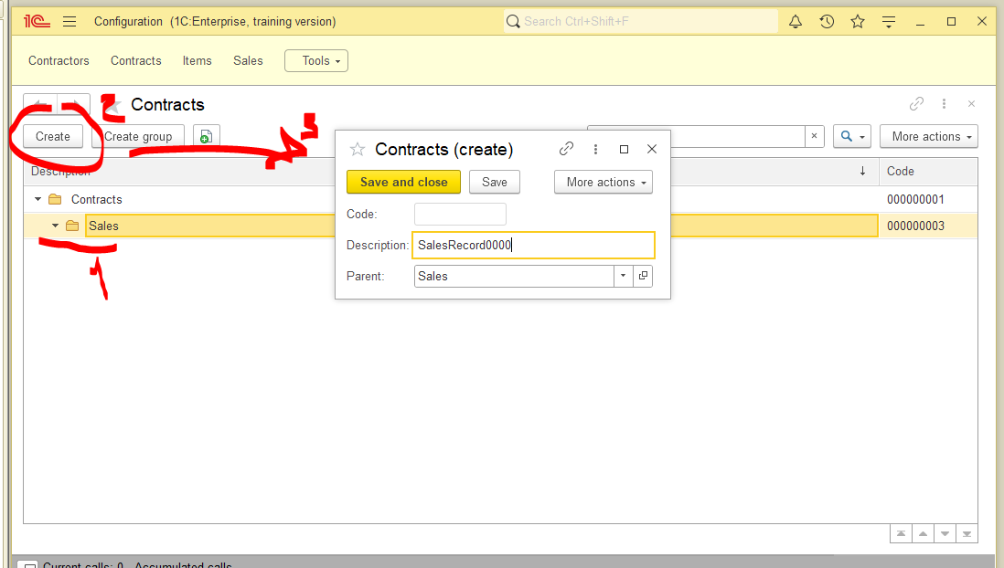
HIERARCHY (FOLDER) ENTERPRISE MODE

Slide 17
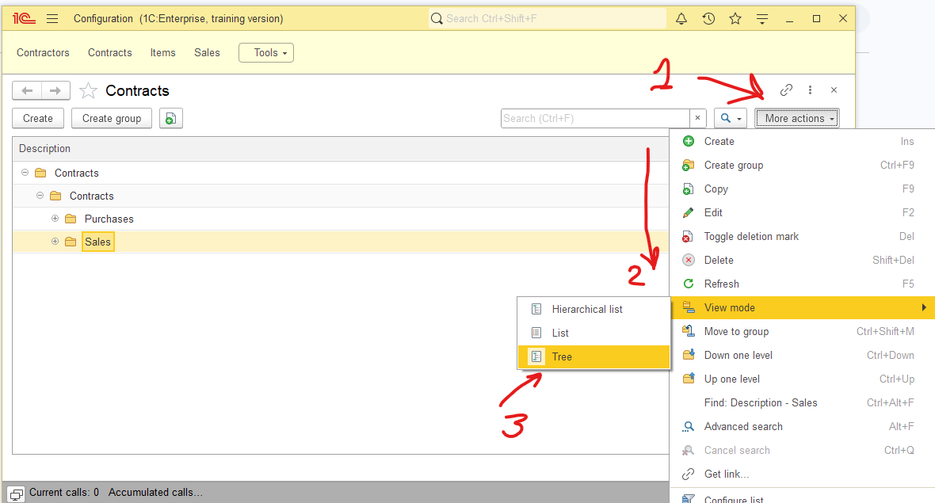
HIERARCHY (FOLDER) ENTERPRISE MODE

Slide 18
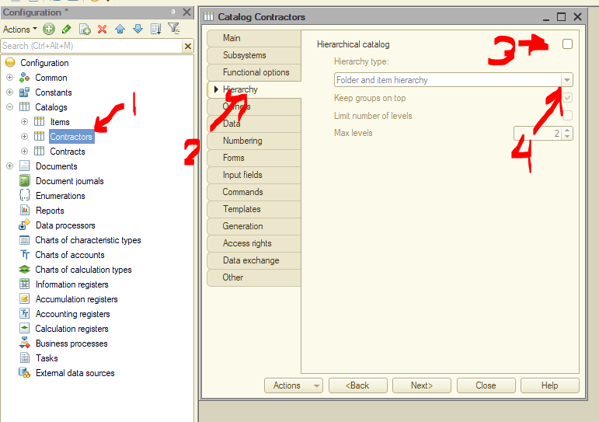
HIERARCHY (ITEM) DESIGNER MODE

Slide 19
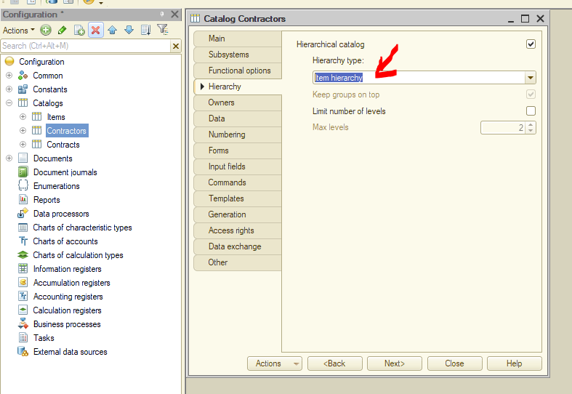
HIERARCHY (ITEM) DESIGNER MODE

Slide 20
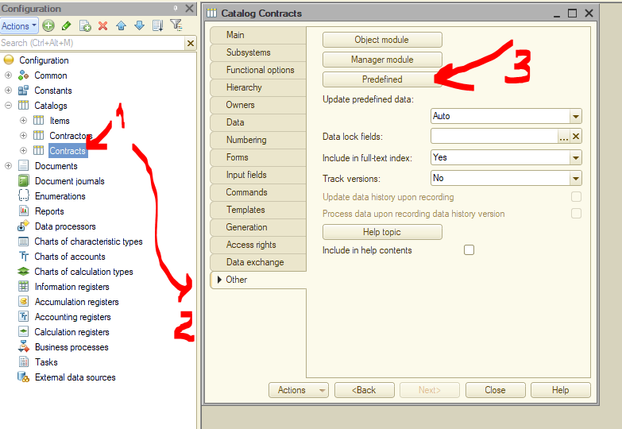
PREDEFINED ELEMENTS DESIGNER MODE

Slide 21
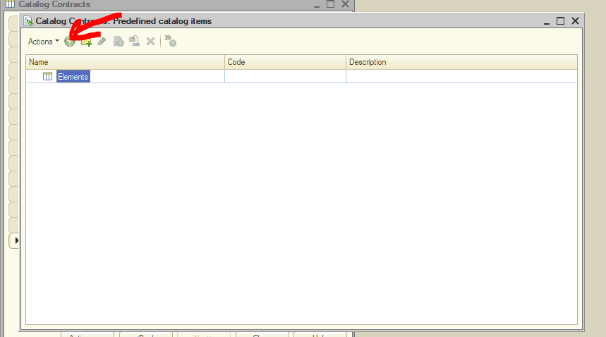
PREDEFINED ELEMENTS DESIGNER MODE

Slide 22
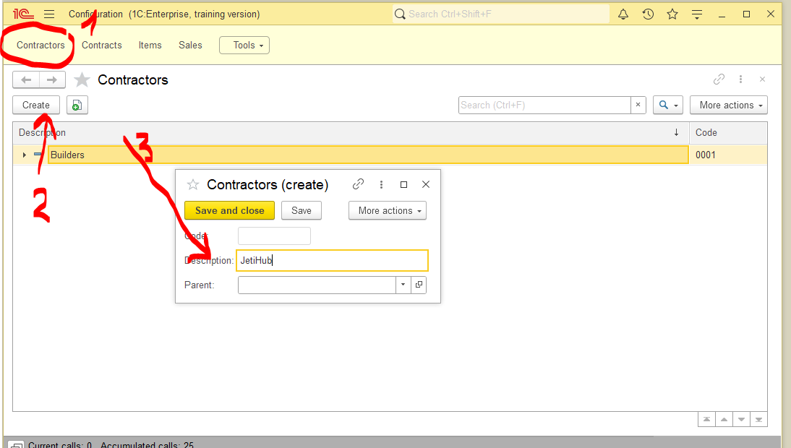
HIERARCHY (FOLDER) ENTERPRISE MODE

Slide 23
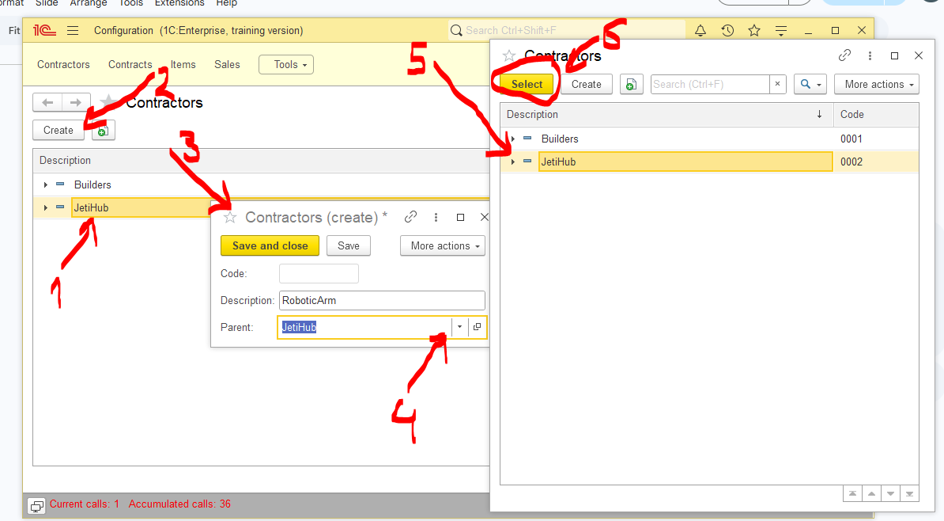
HIERARCHY (FOLDER) ENTERPRISE MODE

Slide 24
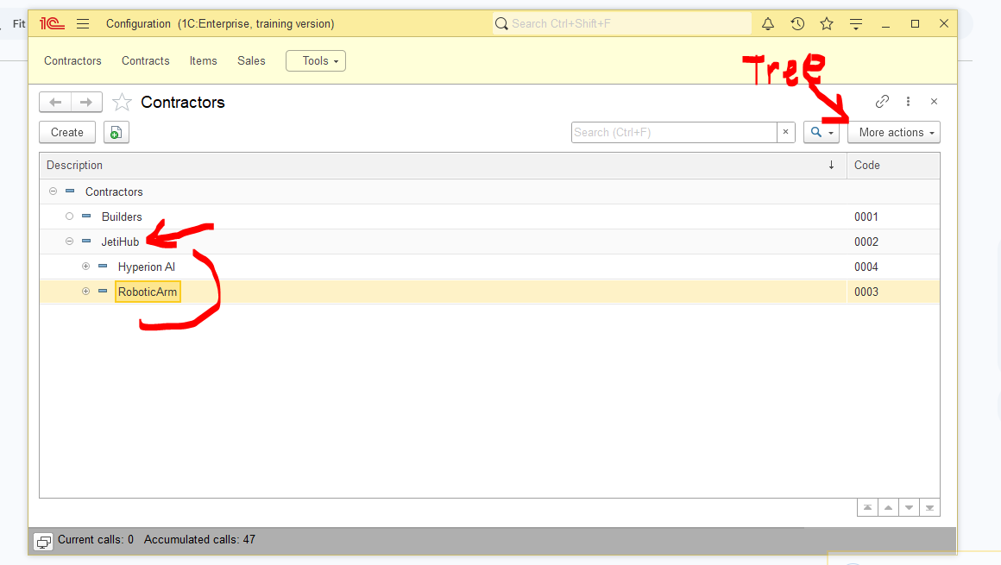
HIERARCHY (FOLDER) ENTERPRISE MODE

Slide 25
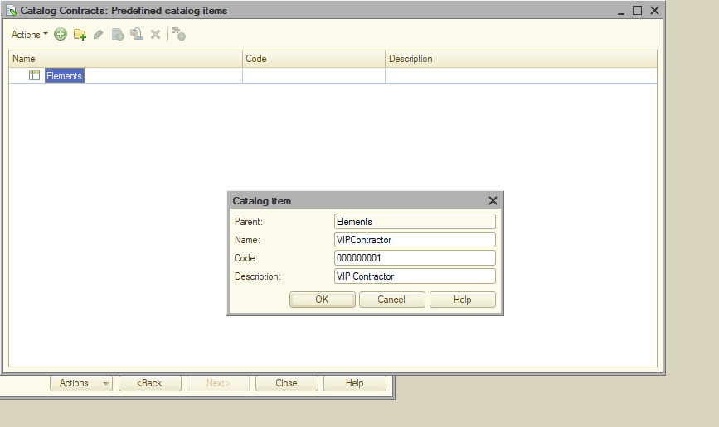
PREDEFINED ELEMENTS DESIGNER MODE

Slide 26
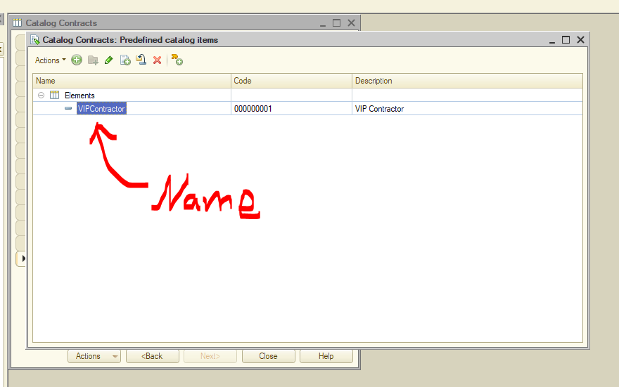
PREDEFINED ELEMENTS DESIGNER MODE

Slide 27
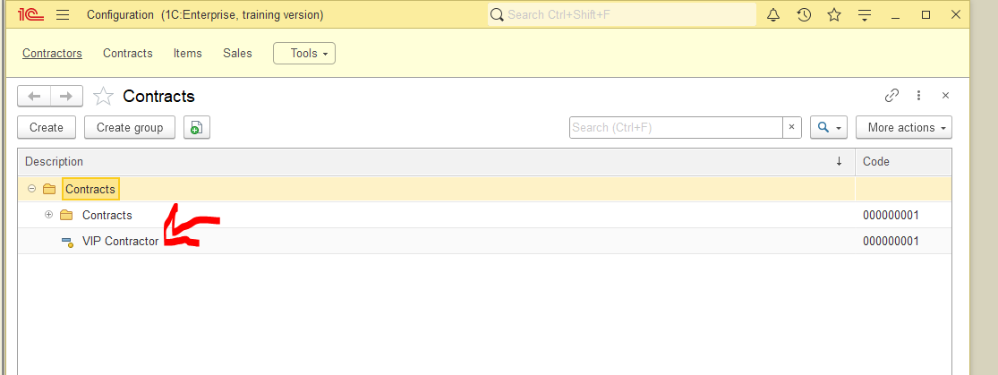
PREDEFINED ELEMENTS ENTERPRISE MODE

Slide 28
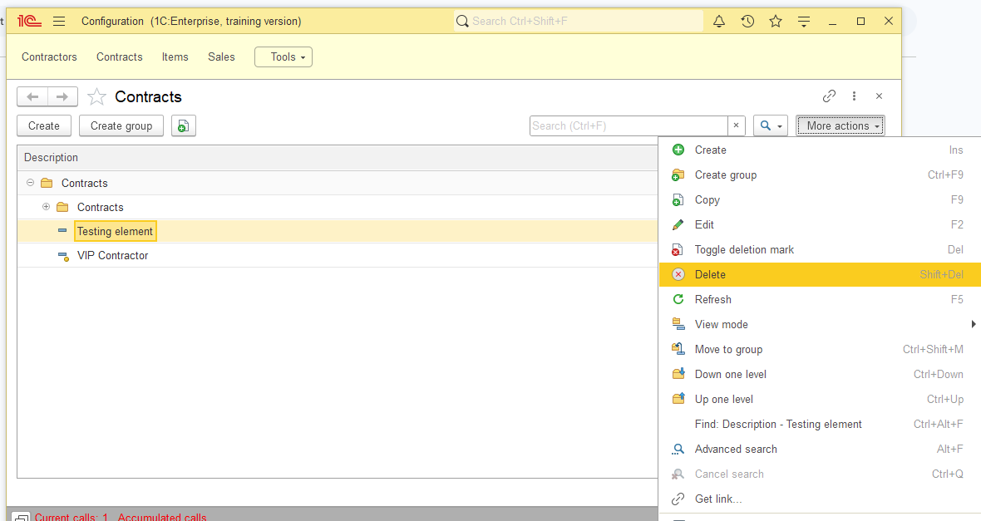
DELETING ELEMENTS ENTERPRISE MODE

Slide 29
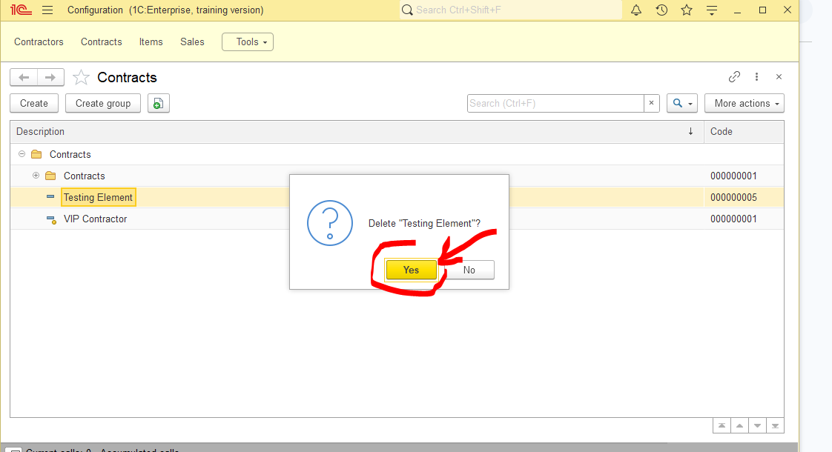
DELETING ELEMENTS ENTERPRISE MODE

Slide 30
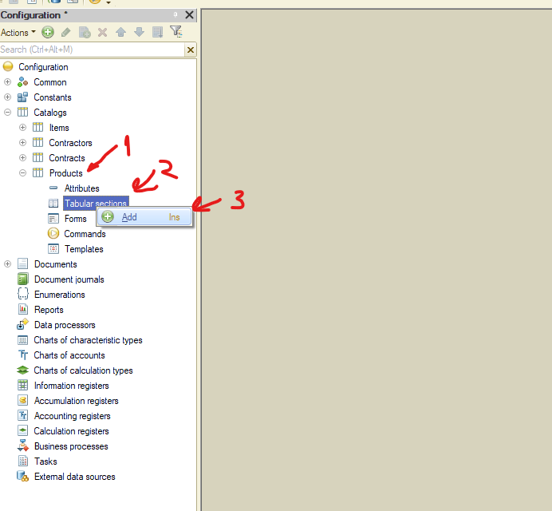
TABULAR SECTION DESIGNER MODE

Slide 31
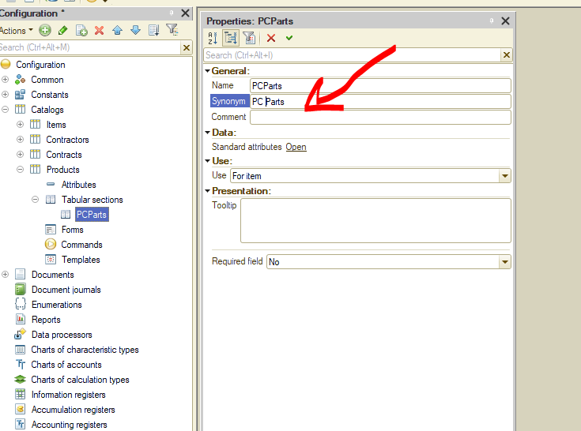
TABULAR SECTION DESIGNER MODE

Slide 32
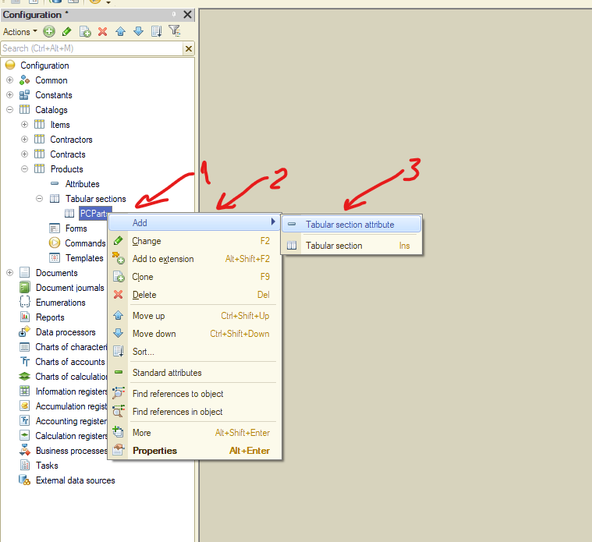
TABULAR SECTION DESIGNER MODE

Slide 33
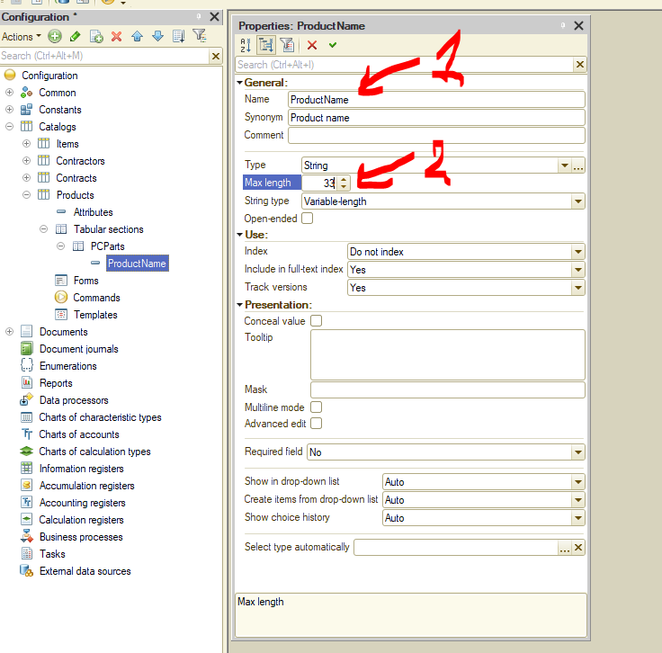
TABULAR SECTION DESIGNER MODE

Slide 34
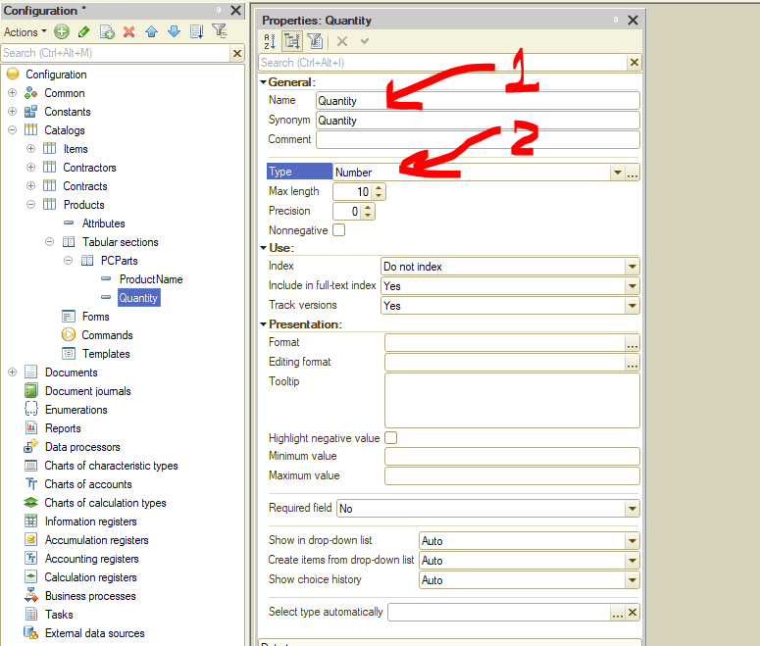
TABULAR SECTION DESIGNER MODE

Slide 35
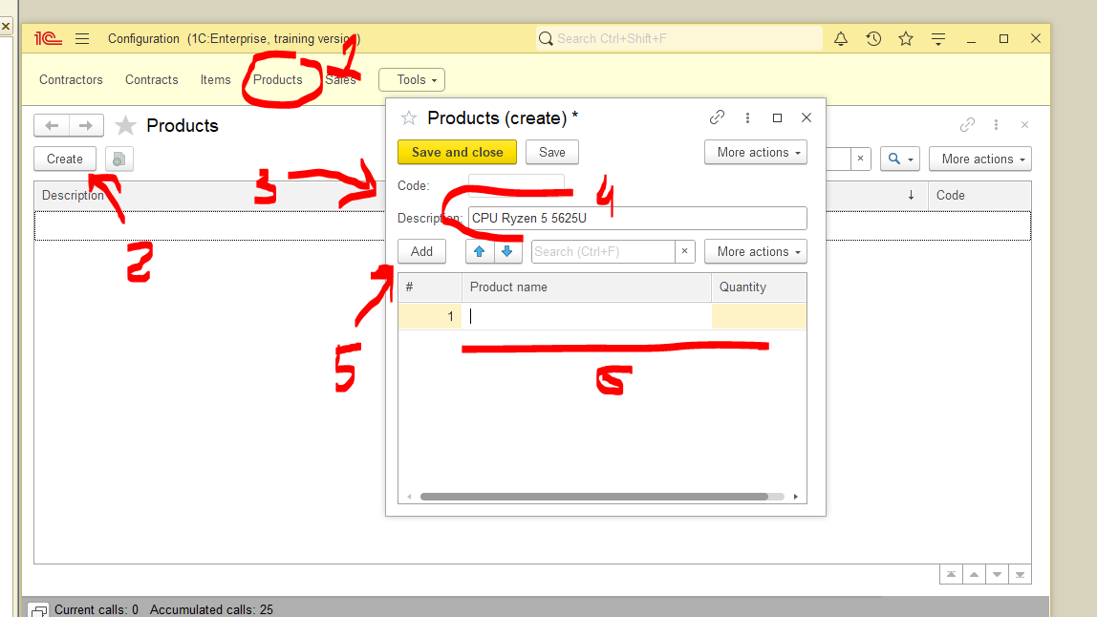
TABULAR SECTION
ENTERPRISE MODE

Slide 36
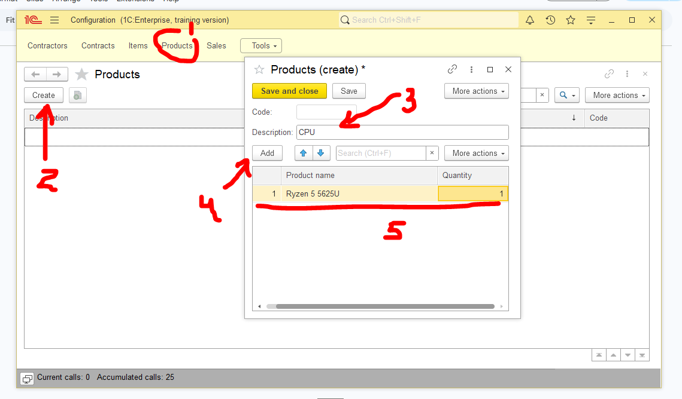
TABULAR SECTION
ENTERPRISE MODE

Slide 37
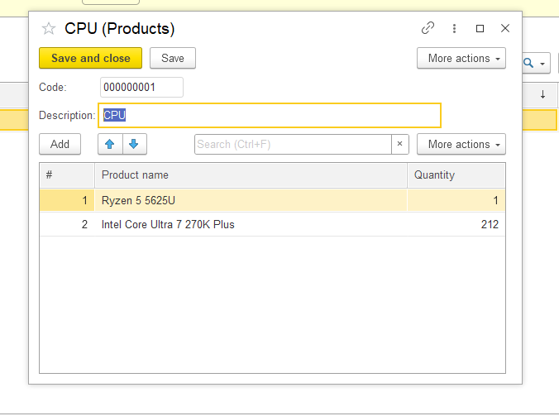
TABULAR SECTION
ENTERPRISE MODE

Slide 38
NEXT WEEK PREVIEW WHAT’S COMING
MORE 1C LABS

